Slide 1
Parallel Lines cut by a Transversal

Slide 2
Investigations
Tools: protractor, straightedge, patty paper
EQ: What can you conclude about the angles formed by the parallel lines that are cut by the transversal.
Objective: Discover relationships between special pairs of angles created by a pair of parallel lines cut by a transversal.

Slide 3
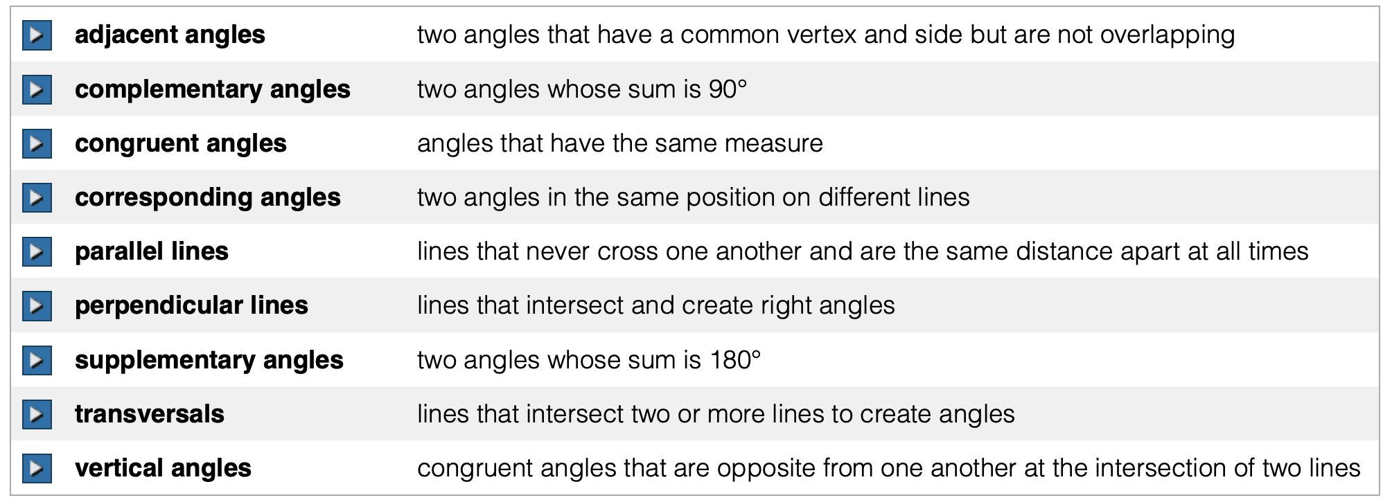


Slide 4
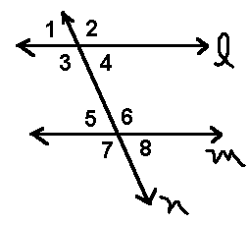
Parallel Lines and Transversals
What You'll Learn
You will learn to identify the relationships among pairs of
interior and exterior angles formed by two parallel lines
and a transversal.

Slide 5
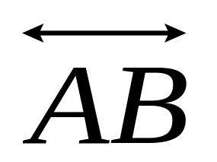
Parallel Lines and Transversals
In geometry, a line, line segment, or ray that intersects two or more lines at different points is called a __________
transversal
A
l
1
2
4
3
m
5
6
8
7
B
is an example of a transversal.
It intercepts lines l and m.
Note all of the different angles formed at the points of intersection.

Slide 6

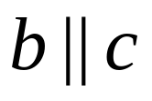
Parallel Lines and Transversals
Definition of Transversal | In a plane, a line is a transversal if it intersects two or more lines, each at a different point.
The lines cut by a transversal may or may not be parallel.
Parallel Lines
Nonparallel Lines
b
2
l
1
1
2
4
3
4
3
m
c
5
6
5
6
8
7
8
7
t
r
t is a transversal for l and m.
r is a transversal for b and c.

Slide 7
Parallel Lines and Transversals
Two lines divide the plane into three regions.
The region between the lines is referred to as the interior.
The two regions not between the lines is referred to as the exterior.
Exterior
Interior
Exterior

Slide 8
Parallel Lines and Transversals
When a transversal intersects two lines, _____ angles are formed.
eight
These angles are given special names.
2
l
1
4
3
m
5
6
8
7
t
Alternate angles lie on opposite
sides of the transversal
Same Side angles lie on the same
side of the transversal
Interior angles lie between the
two lines.
Exterior angles lie outside the
two lines.
Alternate Interior angles are on the
opposite sides of the transversal,
between the lines.
Alternate Exterior angles are
on the opposite sides of the
transversal, outside the lines.
Same Side Interior angles are on
the same side of the transversal,
between the lines.
Same Side Exterior angles are on
the same side of the transversal ,
outside the lines.

Slide 9
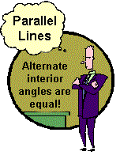


Parallel Lines and Transversals
Alternate Interior Angles AIA | If two parallel lines are cut by a transversal, then each pair of Alternate interior angles is _________.
congruent
1
2
4
3
5
6
8
7

Slide 10


Parallel Lines and Transversals
Same Side Interior Angles SSI | If two parallel lines are cut by a transversal, then each pair of Same side interior angles is _____________.
supplementary
1
2
4
3
5
6
8
7

Slide 11


Parallel Lines and Transversals
Same Side Exterior Angles SSE | If two parallel lines are cut by a transversal, then each pair of Same side exterior angles is _____________.
supplementary
1
2
4
3
5
6
8
7

Slide 12



Parallel Lines and Transversals
Alternate Exterior Angles AEA | If two parallel lines are cut by a transversal, then each pair of alternate exterior angles is _________.
congruent
1
2
4
3
5
6
8
7

Slide 13
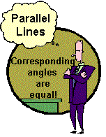
Parallel Lines and Transversals
Corresponding Angles CA | If two parallel lines are cut by a transversal, then each pair of corresponding angles is _________.
congruent

Slide 14

Parallel Lines w/a transversal AND
Angle Pair Relationships
Concept Summary
 | Congruent | Supplementary
Types of angle pairs formed when
a transversal cuts two parallel lines.
alternate interior angles- AIA
same side interior angles- SSI
alternate exterior angles- AEA
same side exterior angles- SSE
corresponding angles - CA
linear pair of angles- LP
vertical angles- VA

Slide 15

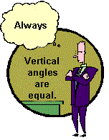
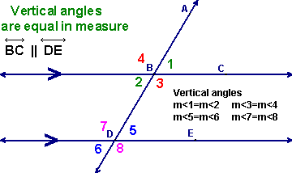
Vertical Angles = opposite angles formed by intersecting lines
Vertical angles are ALWAYS equal, whether
you have parallel lines or not.
Vertical angles are congruent.

Slide 16
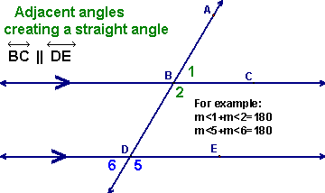
Angles forming a Linear Pair
Linear Pair of Angles = Adjacent Supplementary Angles
measures are supplementary
If two angles form a linear pair, they are supplementary.

Slide 17
Parallel Lines and Transversals
s
t
s || t and c || d.
Name all the angles that are congruent to 1.
Give a reason for each answer.
1
2
3
4
c
5
6
7
8
9
10
11
12
d
13
14
15
16
3  1
corresponding angles
6  1
vertical angles
8  1
alternate exterior angles
9  1
corresponding angles
14  1
alternate exterior angles
1  4
same side exterior angles
5  10
alternate interior angles

Slide 18
Let’s Practice
Parallel Lines and Transversals
m<1=120°
Find all the remaining angle measures.
1
2
60°
120°
3
4
60°
120°
120°
6
5
60°
7
8
120°
60°

Slide 19
Another practice problem
Parallel Lines and Transversals
40°
180-(40+60)= 80°
Find all the missing angle measures, and name the postulate or theorem that gives us permission to make our statements.
60°
80°
60°
40°
100°
80°
120°
60°
80°
100°
120°
60°

Slide 20
SUMMARY: WHEN THE LINES ARE PARALLEL→
♥Alternate Interior Angles
are CONGRUENT
♥Alternate Exterior Angles are CONGRUENT
♥Same Side Interior Angles are SUPPLEMENTARY
♥Same Side Exterior Angles are SUPPLEMENTARY
♥Corresponding Angles are
CONGRUENT
Exterior
1
2
3
4
Interior
5
6
7
8
Exterior
If the lines are not parallel, these angle relationships
DO NOT EXIST.

